Slide 1
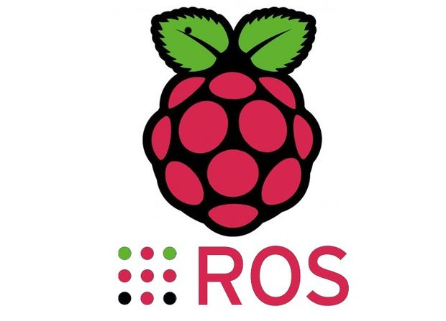

ROS Workshop
-Lecture 3-
Python - Raspberry Pi - Robot Operating System
Husnu Melih Erdogan
Lab Assistant
Intelligent Robotics Lab

Slide 2

Course Structure
Lecture 4 - (Spring - Week 5)
ROS Services and Messages
ROS Action
Writing a Service and Client
ROS .bag file
Lab Assignment 4
Lecture 5 - (Spring - Week 6)
URDF
TF
Getting started with Turtlebot
ROS on Raspberry Pi
Lab Assignment 5
Lecture 6 - (Spring - Week 7)
MoveIt
Creating Vikingbot URDF
Robot_State_Publisher
Joint_State_Publisher
Lab Assignment 6
Lecture 7 - (Spring - Week 8)
Gazebo
Creating a Simple Vikingbot Simulation
Lab Assignment 7
Spring Week 9 - 10
Turtlebot - Vikingbot Project
Lecture 1 – (Spring - Week 1)
What is ROS?
Introduction to ROS
ROS architecture, philosophy, history
How to install ROS?
Python basics
Examples
Lab Assignment 1
Lecture 2 – (Spring - Week 3)
Linux Basics
ROS commands
Getting familiar with the ROS filesystem
How to create a ROS package?
How to build a ROS package?
How to install released ROS packages?
How to build packages from source?
Lab Assignment 2
Lecture 3 - (Spring - Week 4)
ROS Nodes Detail
ROS Topics Detail
ROS Launch Detail
Parameter Server
Writing a Publisher and Subscriber
Lab Assignment 3

Slide 3
Review of Last Week’s Class

Slide 4
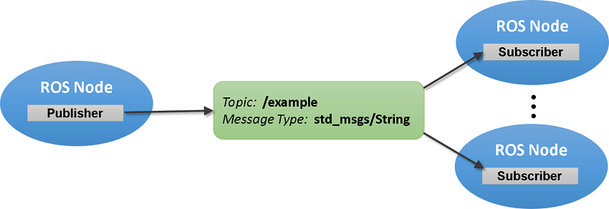
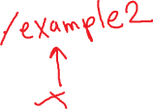
Remapping Arguments
Any ROS name within a node can be remapped when it is launched at the command-line.
http://wiki.ros.org/Remapping%20Arguments

Slide 5
Example 2
Topic: chatter1
Msg: String
Topic: chatter1
Msg: String
Topic: chatter2
Msg: String
Topic: chatter2
Msg: String
talker.py
listener.py
talker.py
listener.py
Student 1
Student 2
Student 3
Student 4
Topic: chatter3
Msg: String
Topic: chatter3
Msg: String
talker.py
listener.py
Student 5
Student 6

Slide 6
How to Create a ROS Package?
Create your workspace
Go to your source directory
cd ~/catkin_ws/src
Create a new package
catkin_create_pkg <package_name> [depend1] [depend2] [depend3]
Build the workspace and source the setup.bash file
cd ~/catkin_ws
. ~/catkin_ws/devel/setup.bash

Slide 7
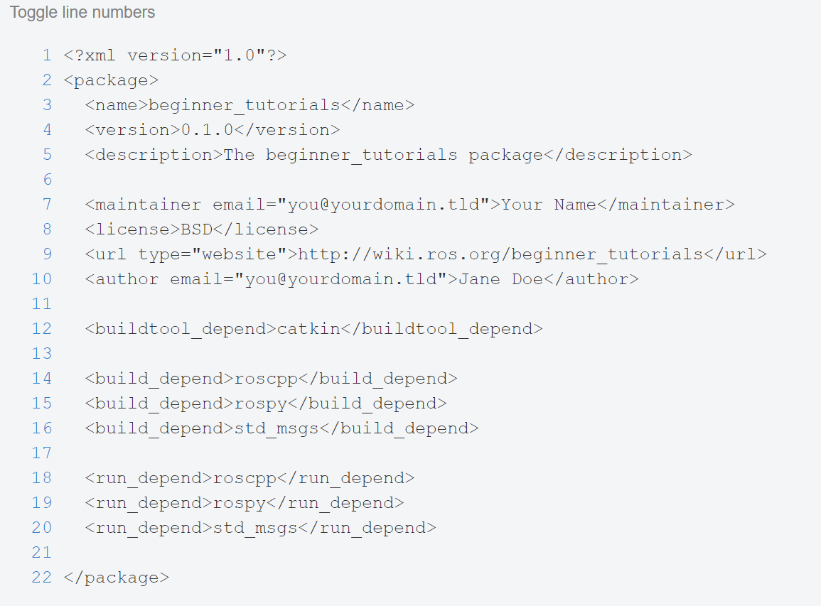




ROS Package Review

Slide 8

VNC
In computing, Virtual Network Computing (VNC) is a graphical desktop sharing system that uses the Remote Frame Buffer protocol (RFB) to remotely control another computer. It transmits the keyboard and mouse events from one computer to another, relaying the graphical screen updates back in the other direction, over a network. ^{(Wikipedia)}

Slide 9
Rostopic Echo
Rostopic echo is used to show that data published on a certain topic
rostopic echo /turtle1/cmdvel
Let’s do an example

Slide 10
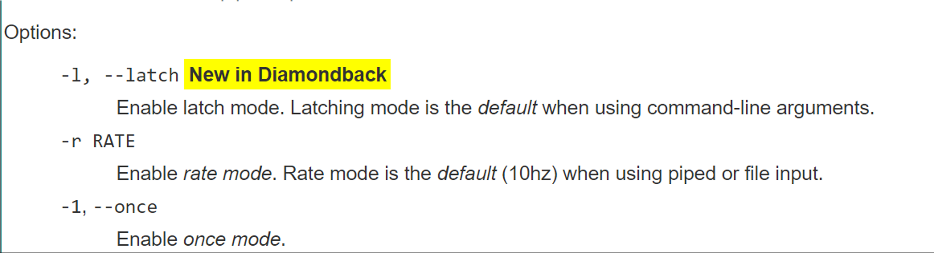
Rostopic Pub
Publishes data to a topic
rostopic pub /topic_name std_msgs/String Perkowski

Slide 11
Subscriber Node
Create a new package
Create a directory called scripts
Create a new file for your python script

Slide 12
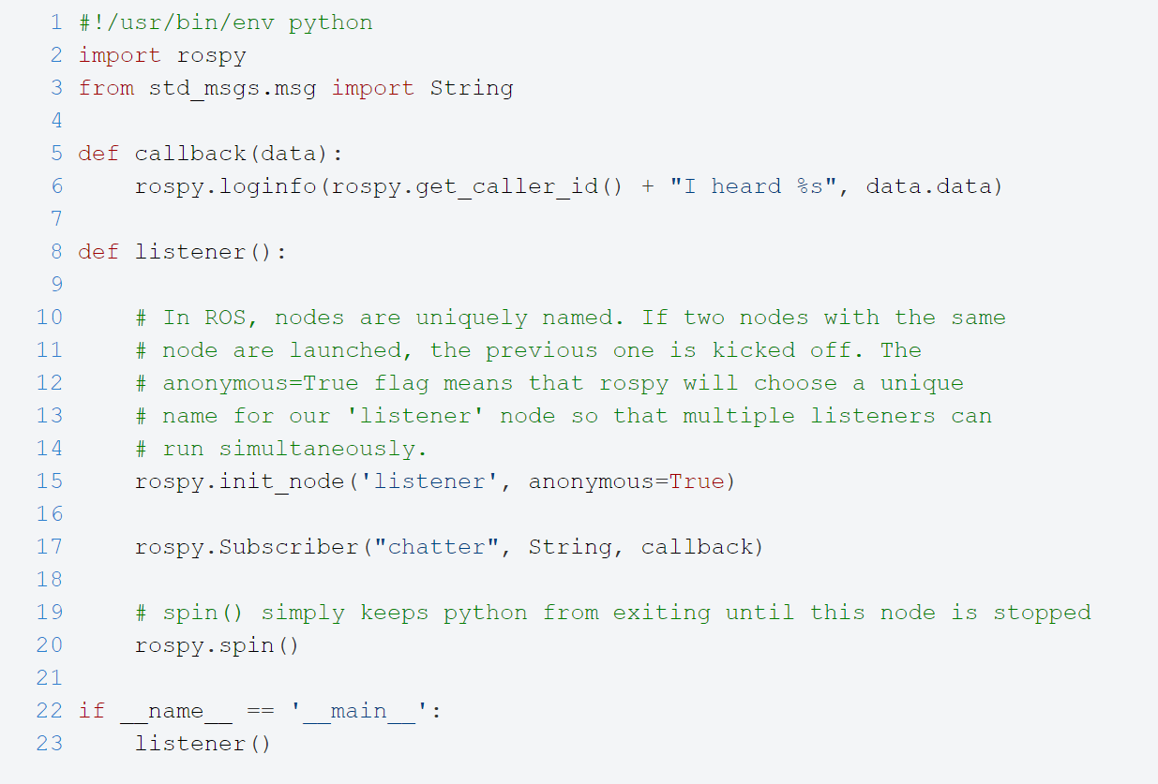
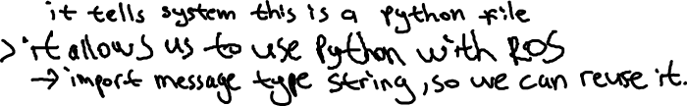
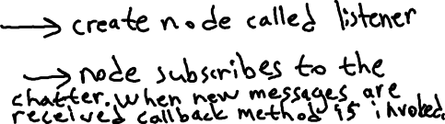

Slide 13
Subscriber Node
Save the file. Name it subscriber1.py
Make the node executable
chmod +x subscriber1.py

Slide 14
Publisher Node
Create a new file for your python script

Slide 15
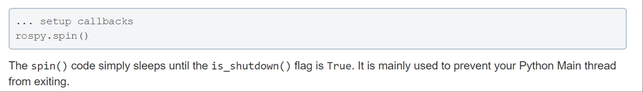
Answers and News
Vim is installed
What does rospy.Spin() do?

Slide 16
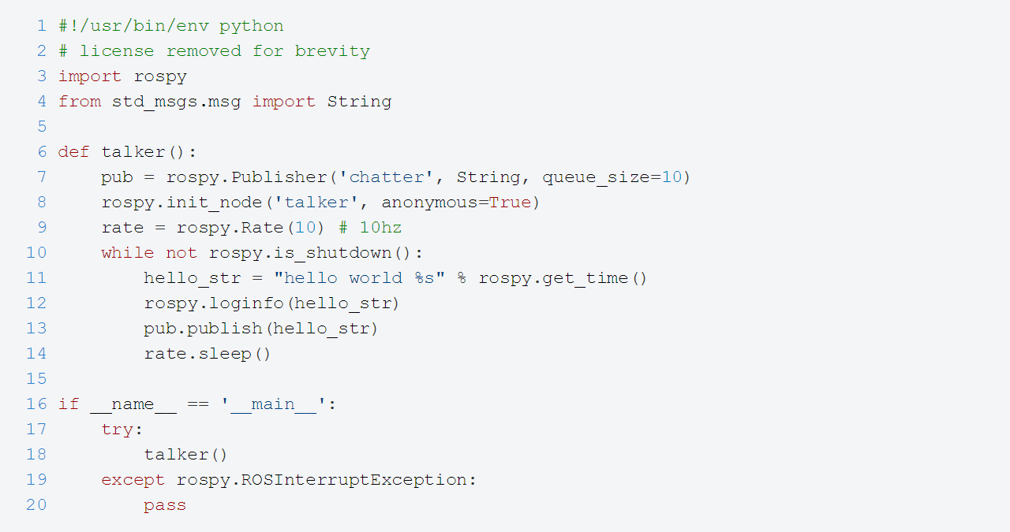
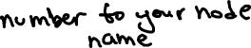

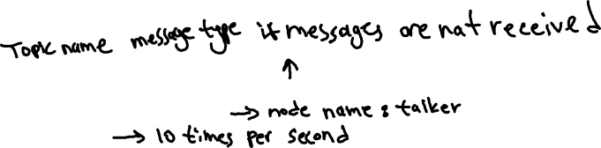
Publisher Node

Slide 17

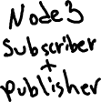
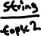





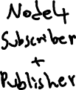

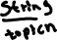
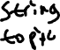






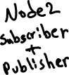

Telephone Game

Slide 18
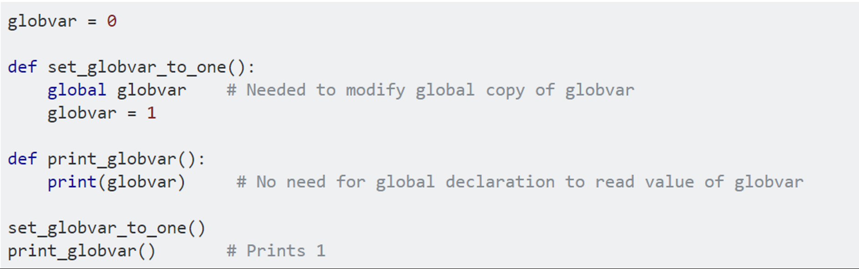
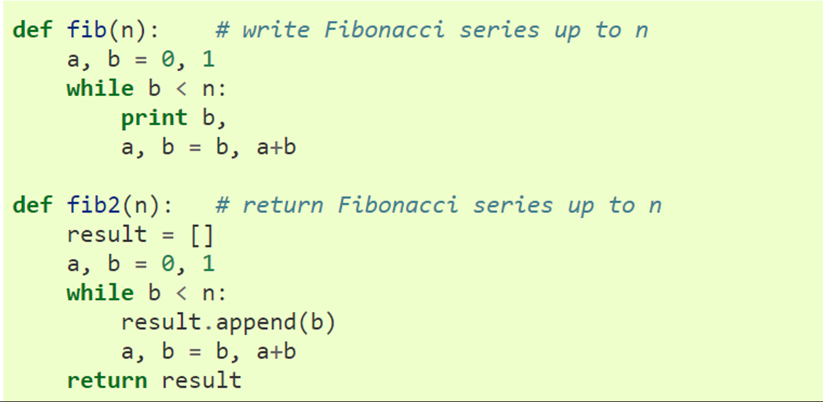
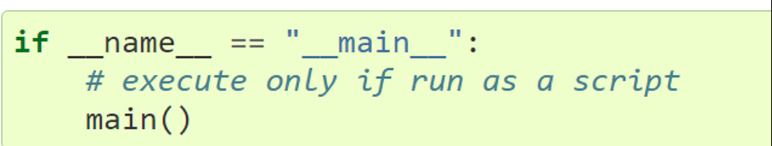
Useful Python Tips

Slide 19
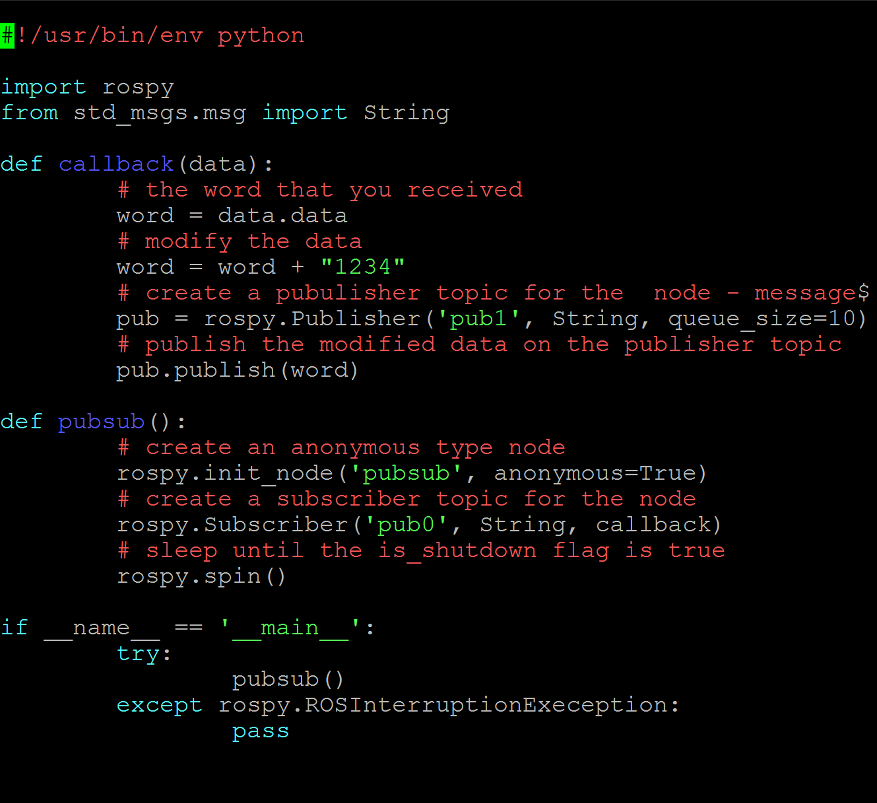


Slide 20

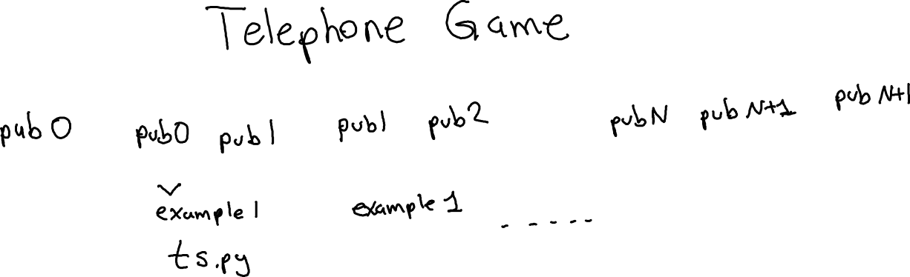



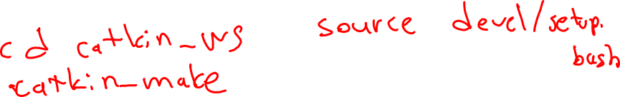
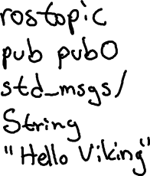


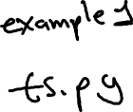


Slide 21
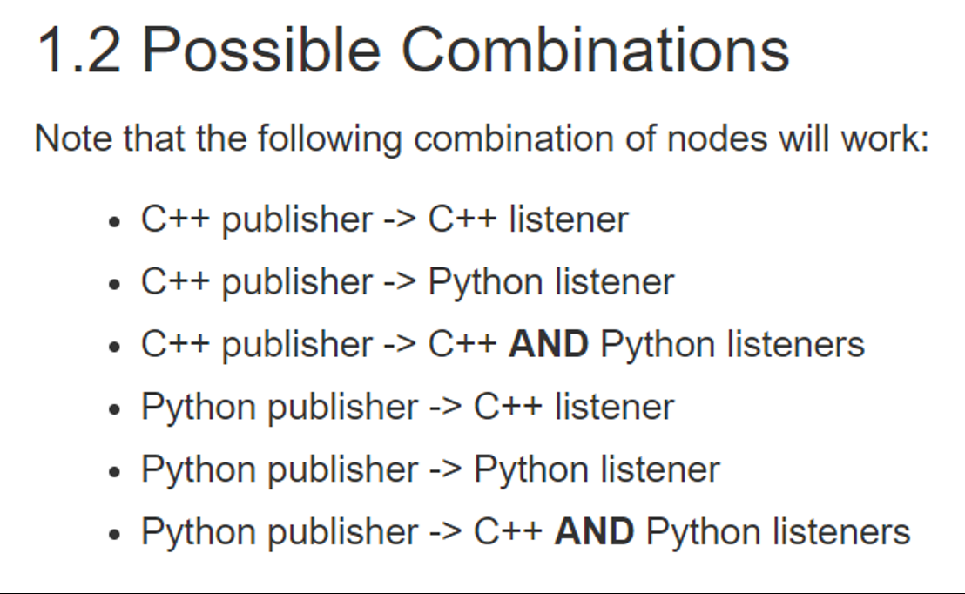



Slide 22


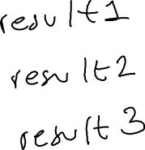


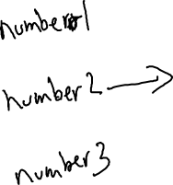
Example 2

Slide 23
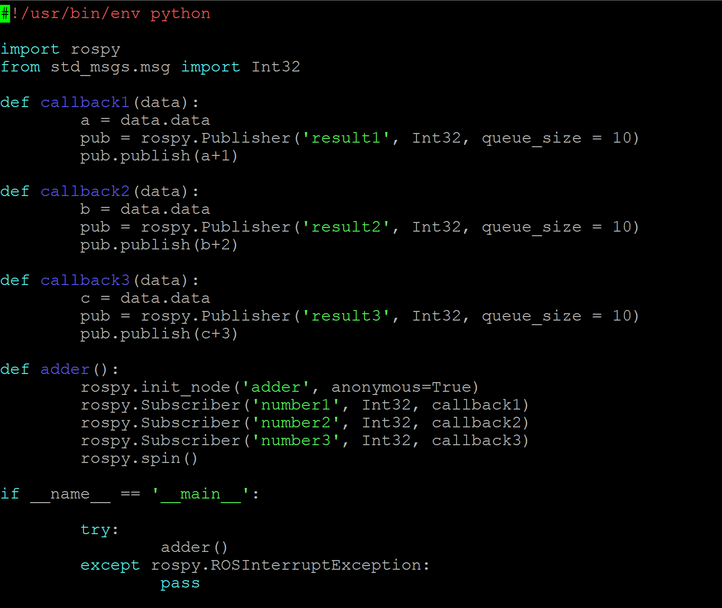
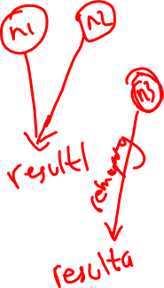

Slide 24






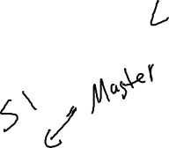














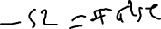


Slide 25
Let’s start with creating a new ROS package
- cd ~/catkin_ws/src
catkin_create_pkg example2 std_msgs rospy
cd ~/catkin_ws
. ~/catkin_ws/devel/setup.bash
catkin_make
Creating the python script
cd example2
cd scripts
chmod +x lgs.py

Slide 26
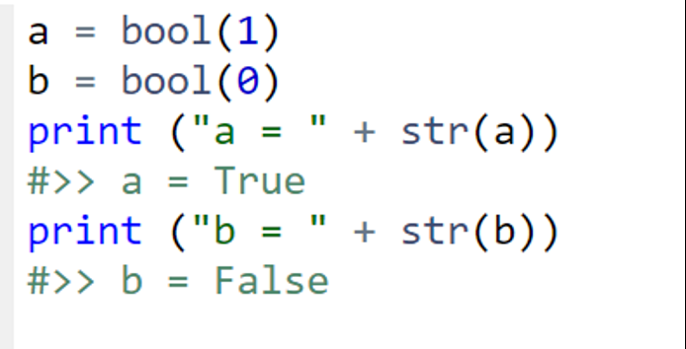
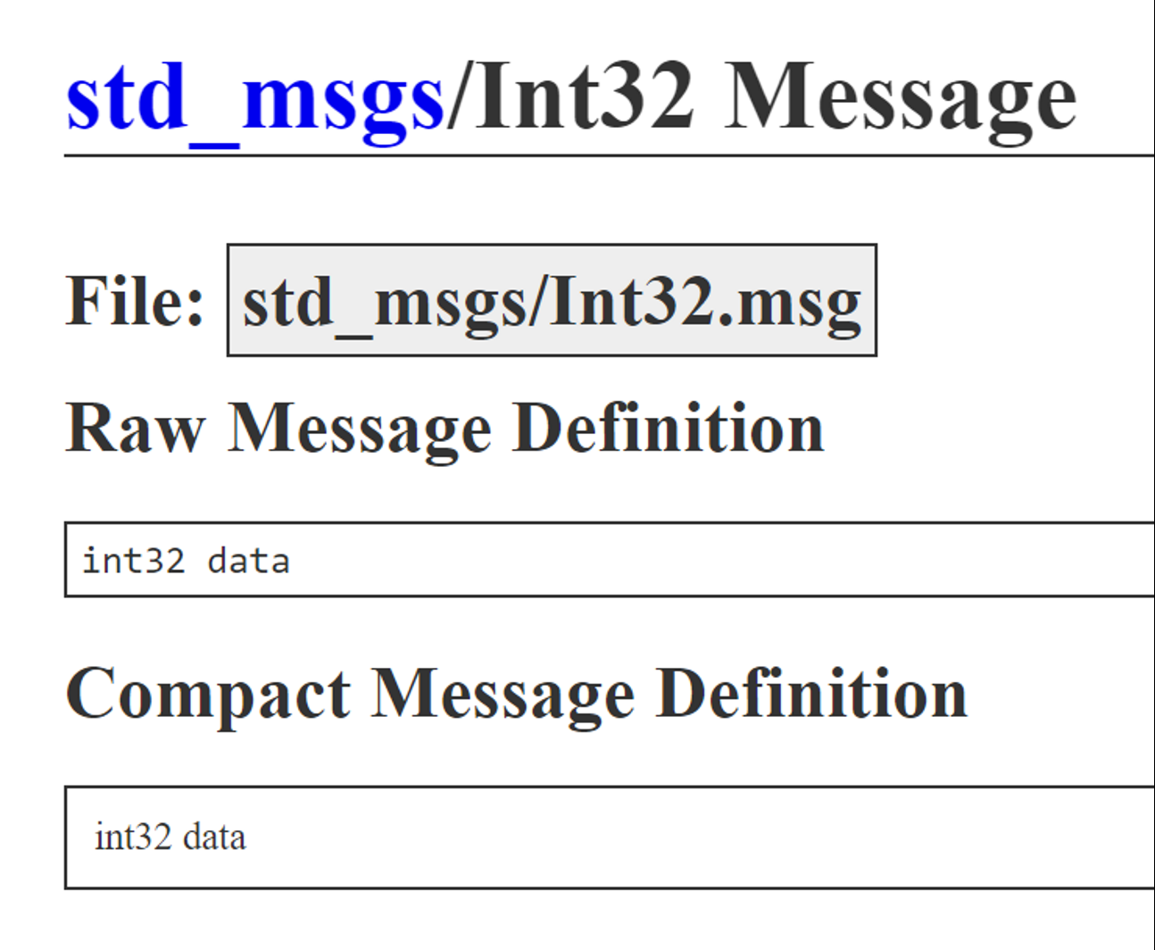
Useful Python and ROS Tips
from std_msgs.msg import Int32
self.get_queue_pub = rospy.Publisher('get_queue', Int32, queue_size=10)

Slide 27
Publisher Node
Save the file. Name it publisher1.py
Make the node executable
chmod +x pbulisher1.py
cd ~/catkin_ws
catkin_make

Slide 28
ROS Launch
roslaunch is a tool for easily launching multiple ROS nodes locally and remotely
It also allows you to set parameters on the Parameter Server.
How to run a launch file:
roslaunch package_name file.launch

Slide 29
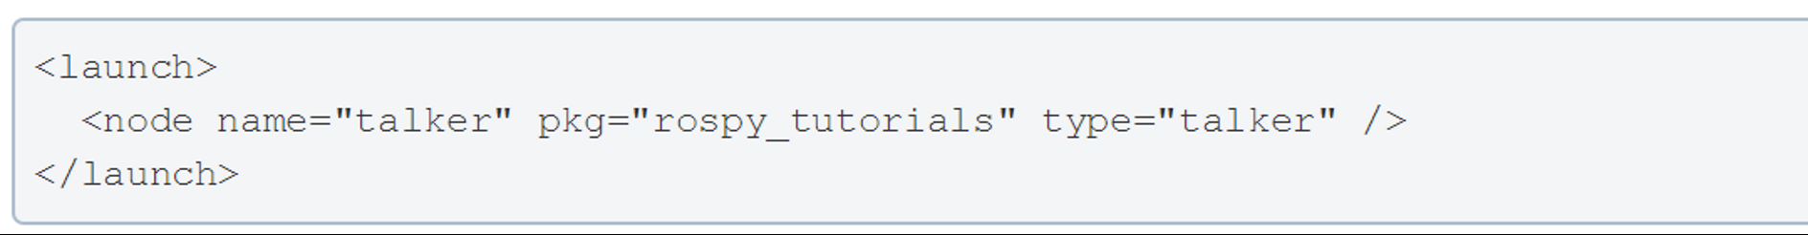
Simple ROS Launch File

Slide 30
ROS Launch Example

Slide 31
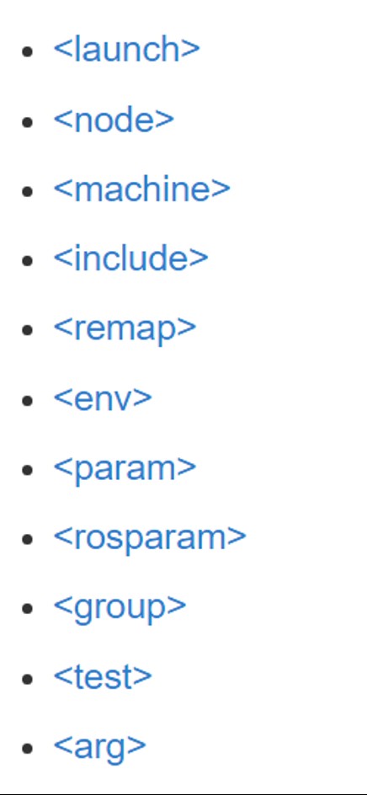
Launch file xml tag references

Slide 32
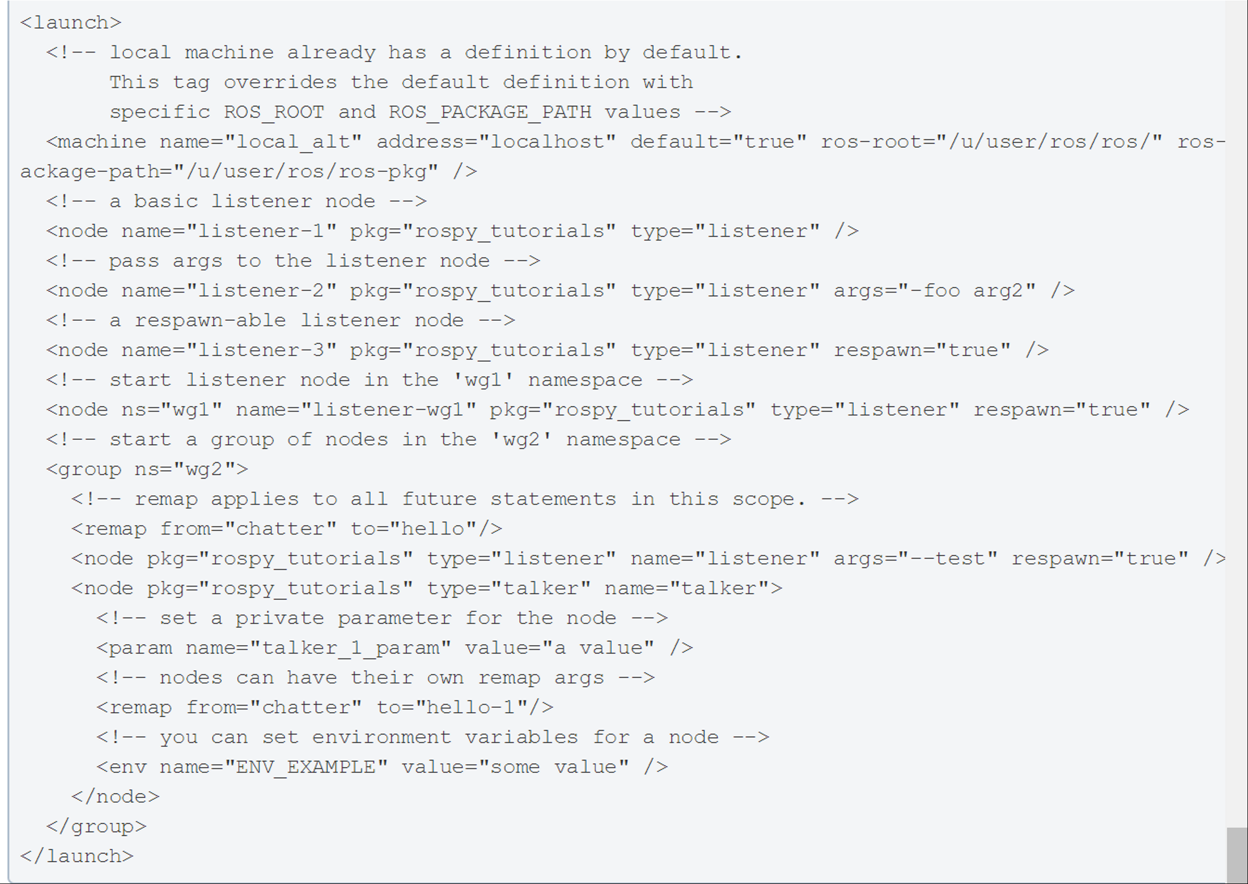
A Little bit more complicated one
- respawn="true"(optional) :Restart the node automatically if it quits.
- respawn_delay="30" (optional, default 0) New in ROS indigo : If respawn is true, wait respawn_delay seconds after the node failure is detected before attempting restart.

Slide 33
Parameter Server
The ROS Parameter Server can store strings, integers, floats, booleans, lists, dictionaries, iso8601 dates, and base64-encoded data. Dictionaries must have string keys.
In addition to the messages that we’ve studied so far, ROS provides another mechanism called parameters to get information to nodes.
Anyone can set the parameter
Anyone can have access to the paramter
rospy.set_param(param_name, param_value)

Slide 34
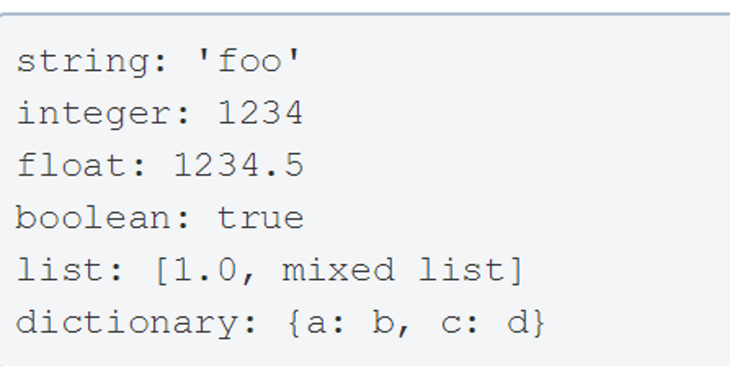
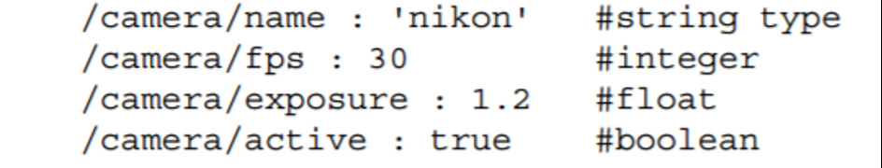
Parameter YAML Format and Examples
We can also store dictionaries on the parameter server.
If the number of parameters is high, we can use a YAML file to save it. Here is an example of the YAML file parameter definitions:

Slide 35
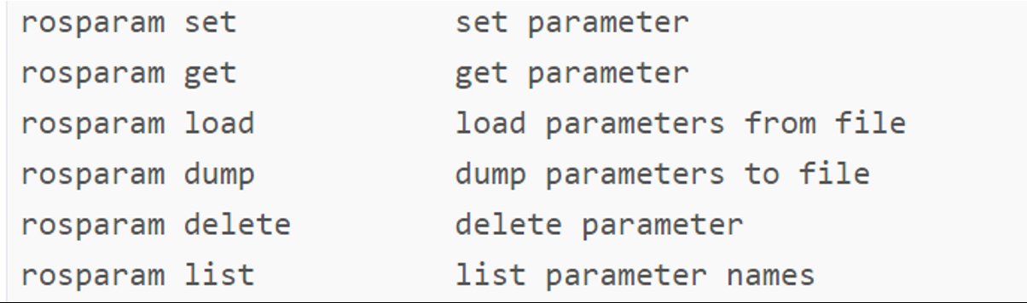
Parameter Server Usage
When you run roscore to start ROS Mater, it also starts parameter server too.

Slide 36
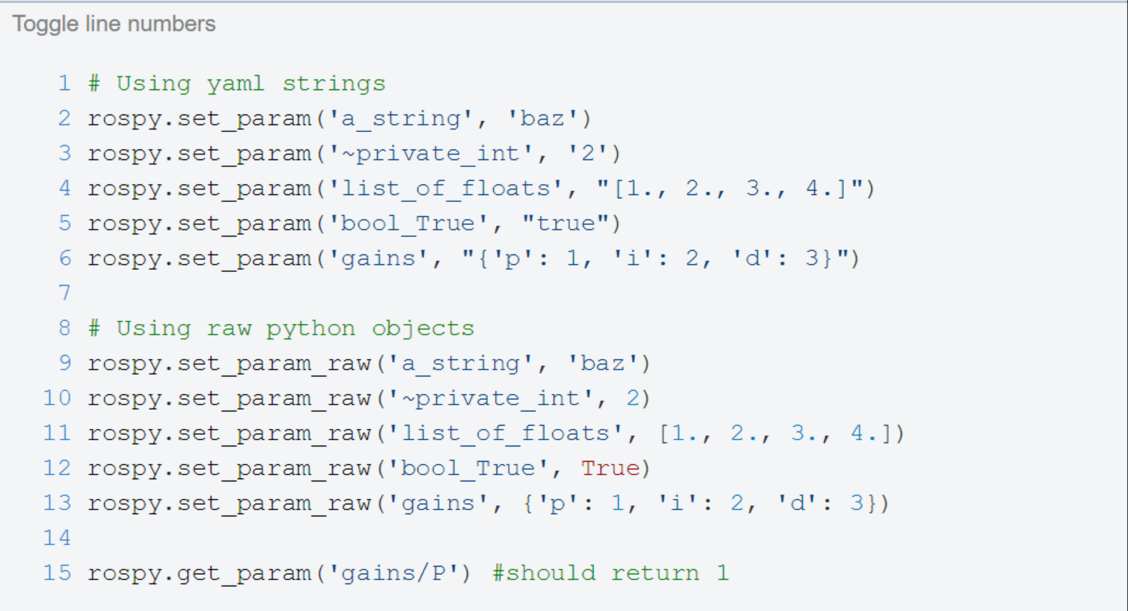
Parameter Example

Slide 37
Parameter Server Commands
Parameters can be can be viewed and changed directly from a terminal using various rosparam commands. The simplest command lists all of the currently active parameters.
rosparam list
With a Husky gazebo simulation running, the following is an example of the output of rosparam list and gives us a good idea the type of values that are best suited for the parameter server.
The rosparam get command can be used to determine the value of a parameter.
rosparam get
For example, we can see that gravity in the z direction in Gazebo is set to -9.8, and we are currently running ROS hydro.
It is also possible to change a parameter using rosparam set
rosparam set parameter_name <value>

